Slide 1
COURSE 2
TOPIC: CULTURE

Slide 2
What does the word culture mean to you?
Students have 5 minutes to write down what culture means to them - brain storming.
RESULTS: art, science, behaviour, customs, traditions, heritage of civilisation, religion, national symbols, events, national language, literature ...
DISCUSSION: some students were convinced that they were wrong, but I told them that this is all culture, because culture is a very broad term.

Slide 3
The connection between culture and literature and language
My learning objectives from the curriculum for the course that is meaningful for the class.
RESULTS: art, science, behaviour, customs, traditions, heritage of civilisation, religion, national symbols, events, traditions, national language, literature ...
OUR GOAL: to connect these four terms together in our research on the birth of Slovenian literature and language.

Slide 4
Researching and learning about the birth of Slovenian language and literature
We have started to learn about the beginnings of Slovenian literature and language. This happened in the 9th century.
During the Middle Ages, the language evolved and changed. We started to learn about this by researching and reading religious texts, because we had no other non-religious texts.
The greatest progress in our language came in the 16th century, when we got the first Slovenian printed book and, with it, the Slovenian language. This was done by Primož Trubar, who united the different dialects into one language.
And most importantly - with the birth of the Slovene language, we also get the beginning of Slovene literature. The credit for this goes to the priests and the monasteries.

Slide 5
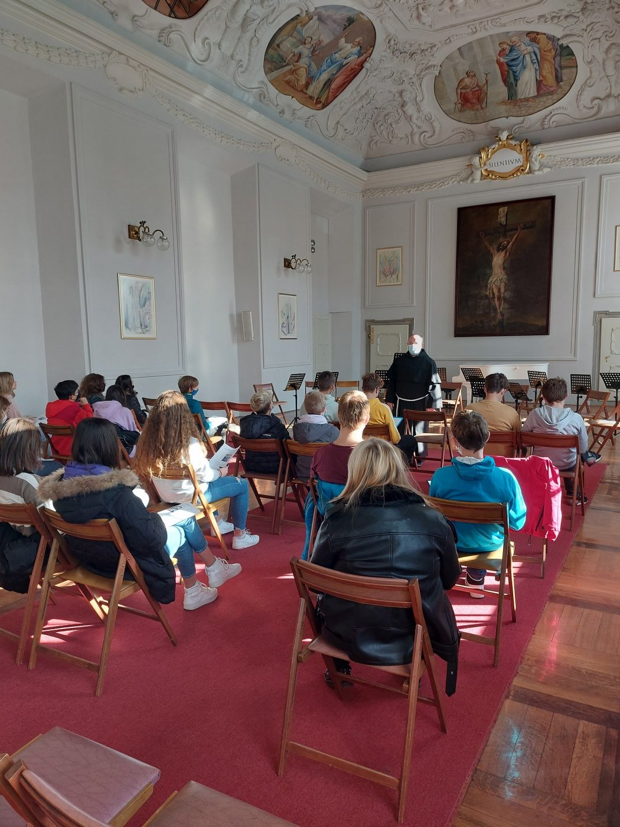
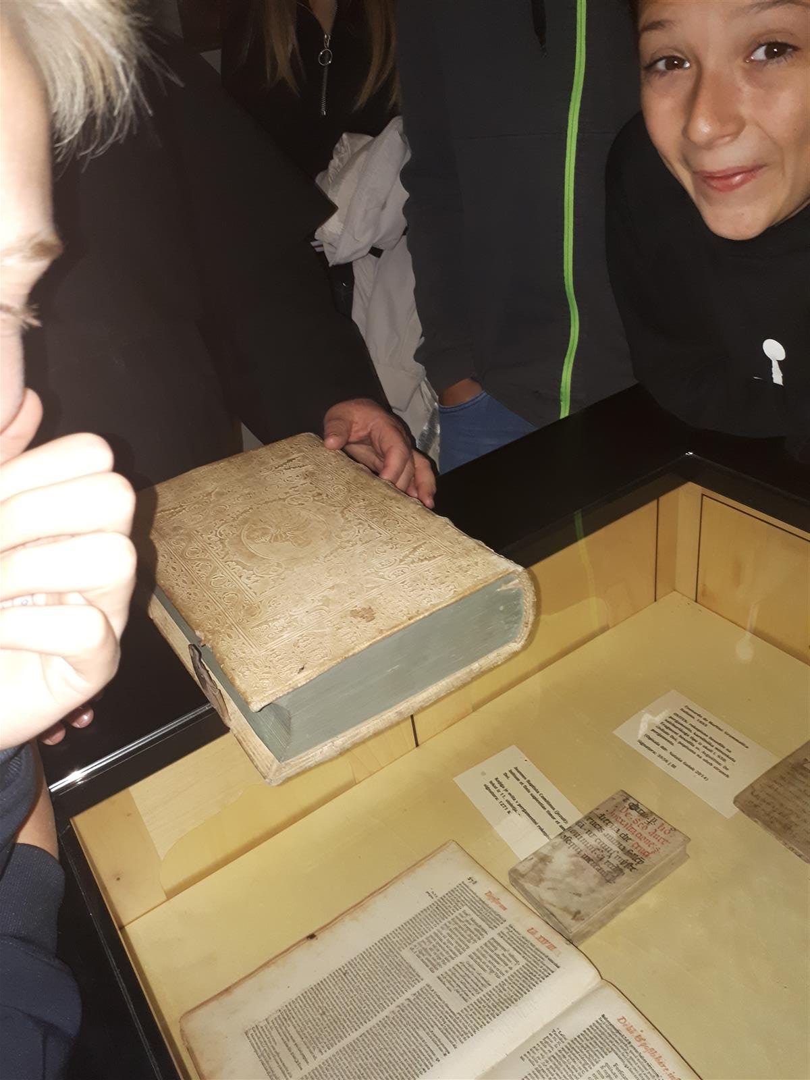
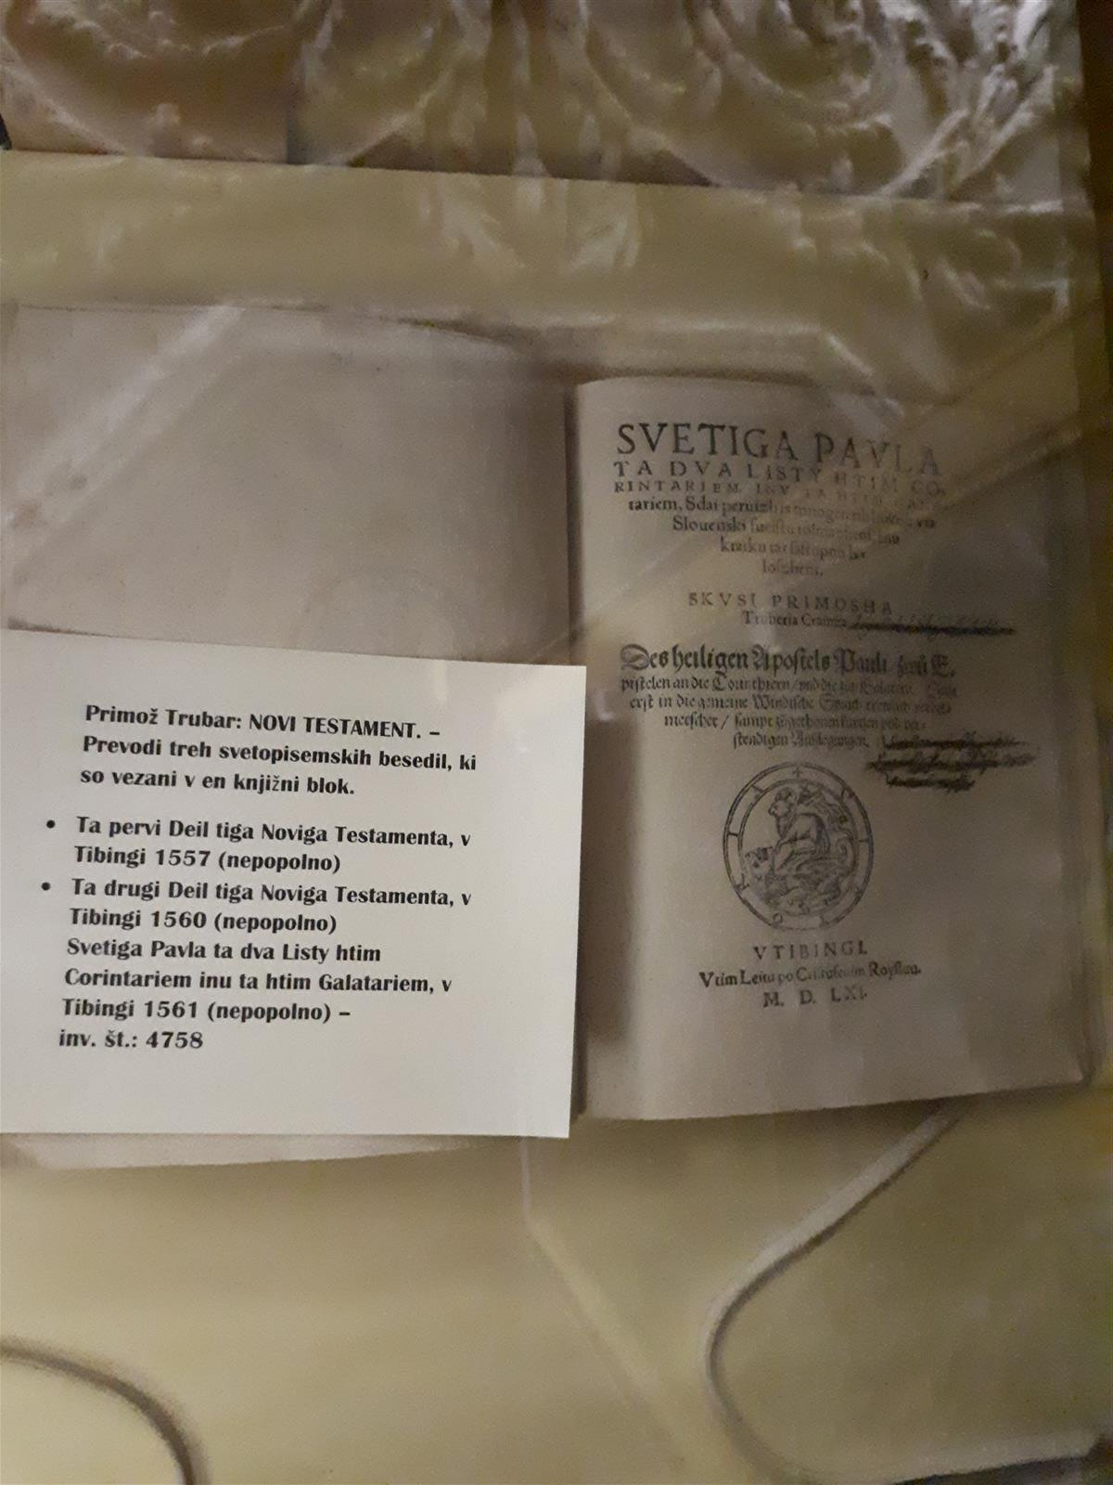
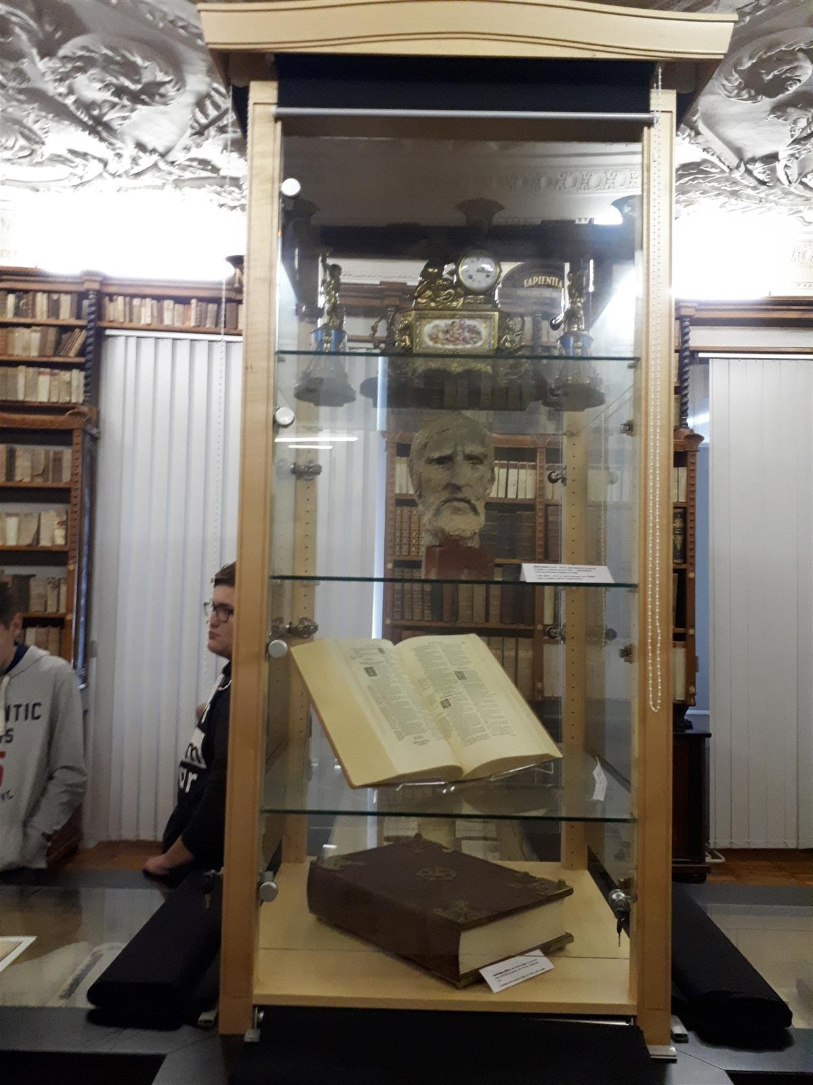
Minorite monastery Ptuj

Slide 6
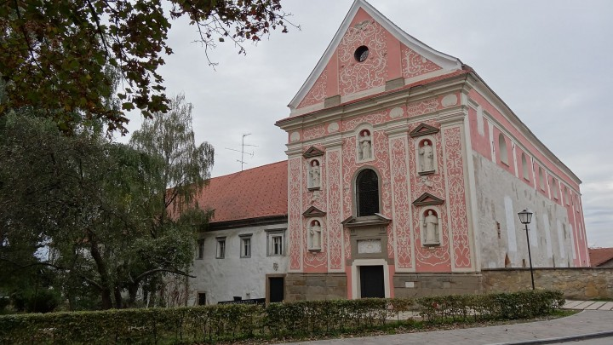
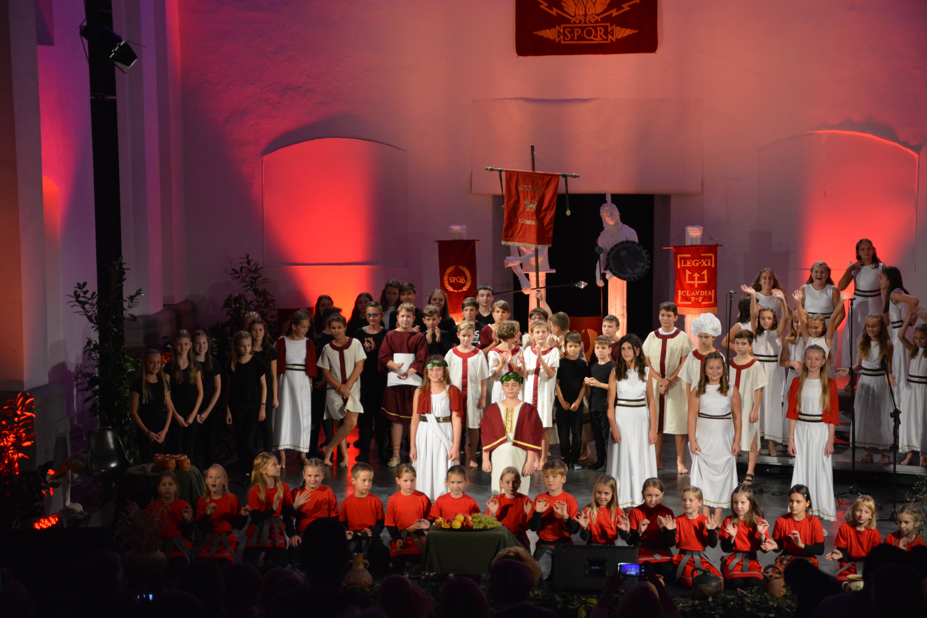
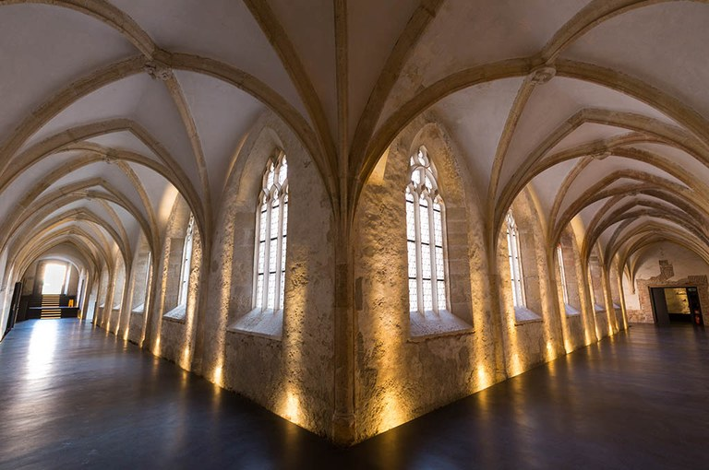
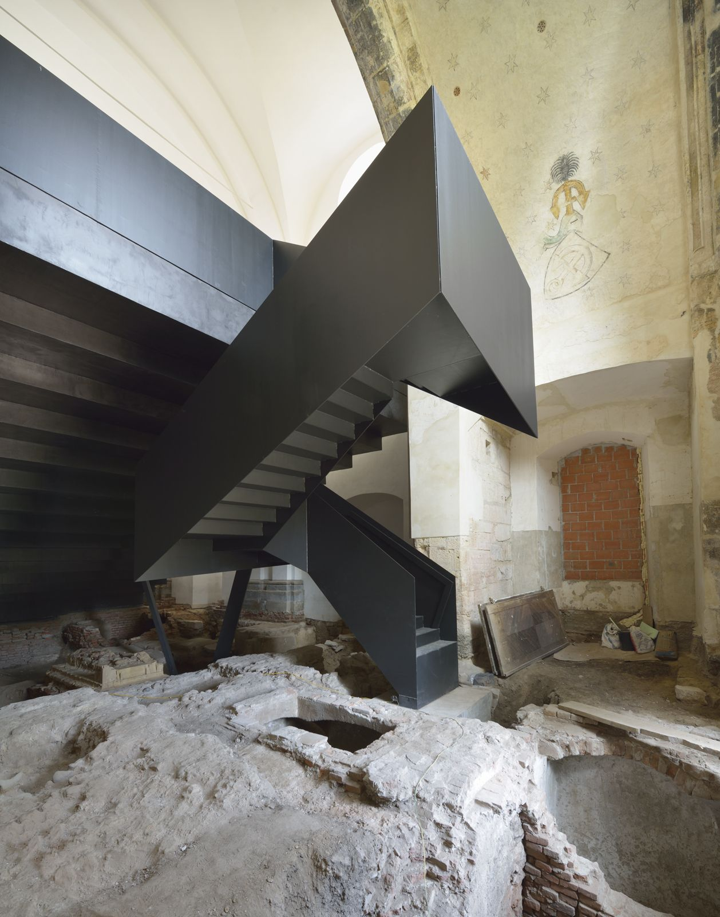
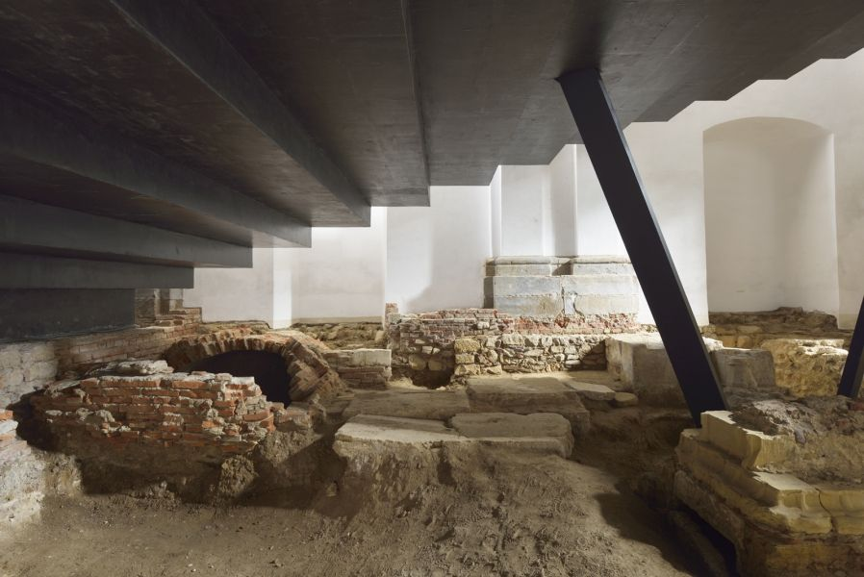
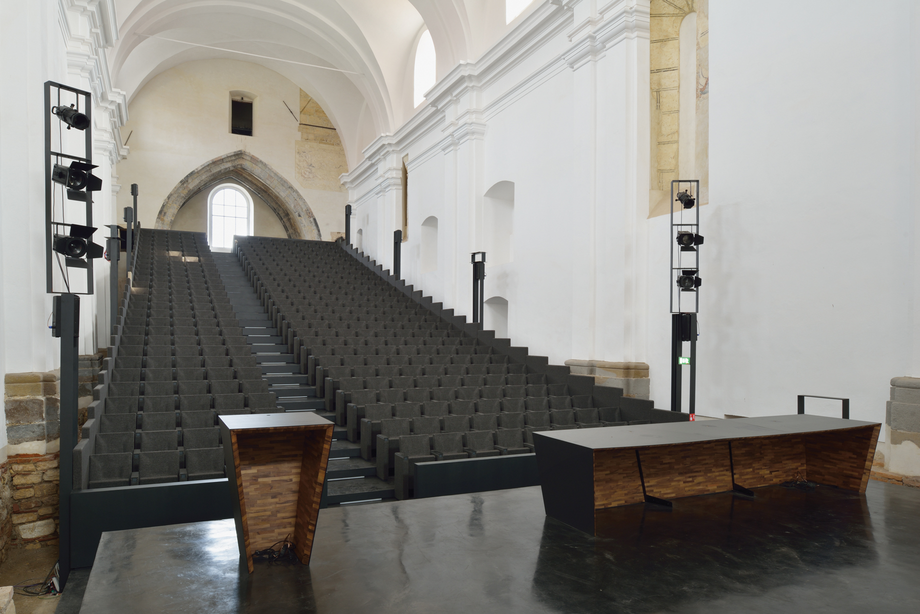
Dominikan monarstery

Slide 7
PREPARING THE KAHOOT GAME
First, they worked in groups or pairs to come up with interesting questions and four possible answers for each question.
Each group or pair was asked to come up with 3 questions and answers.
These questions were then given to me for review and if any question was repeated, I removed it. Then we assigned two students to make the game.
For me as a teacher, this was the best part, because they were learning, repeating, being creative, everyone was working together, looking through books, notebooks, the internet, etc.

Slide 8
Introduce the location based activity
Prepare the location based activity in a relevant app – TurfHunt/ Locatify, Find2Learn, TeachOUT ...
Here we will focus on medieval buildings, especially monasteries and their parts, because monasteries were centres of culture, education, meeting, health resorts, hospitals, etc.

Slide 9
CULTURAL DART BOARD
Introducing the ”Cultural Dart board”
What is culture and possibly the different cultural categories.

Slide 10
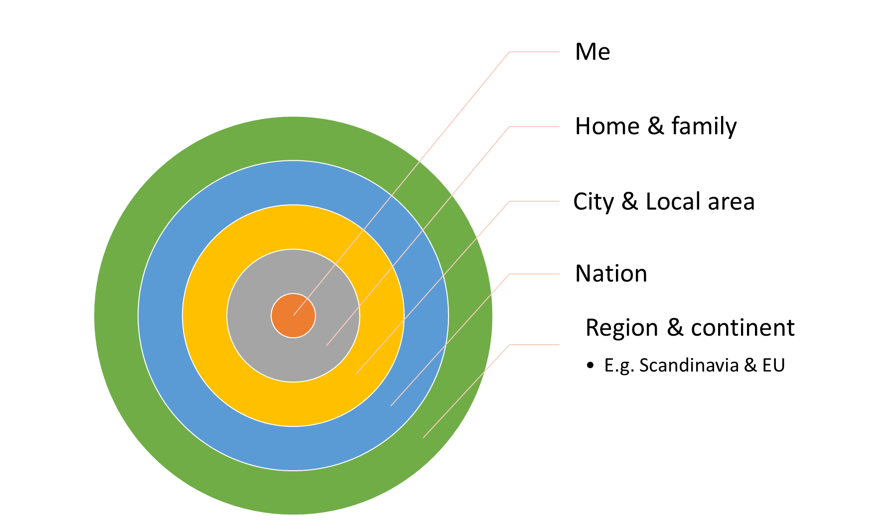

Slide 11
Introducing Content: What is culture and possibly the different cultural categories.
ME | HOME AND FAMILY | CITY AND LOCAL AREAS | NATION | REGION AND CONTINET
WHO AM I? Name Age Picture Favorite food Favorite things Interest/ hobby Taste in Music | Picture of your home Family members Common interests Music Interests Traditions: holidays Food Song Dates | School Sports clubs Buildings Surroundings Places Municipality Social organizations Politics History | Flag Politics Common traditions Music Sports Food - drink History Anthem Religion: You and your nation Language: You and the nation | Conventions EU Nato Music Politics Combined nations History Type of Government

Slide 12
DISCUSSION THROUGH PLAY
First they have to make their dart board and fill it in.
When they do, we will play and have a discussion in class.

